Slide 1
Synchronization and deadlock in java
AbdElraouf Sabri

Slide 2
Outline
Synchronization
  Volatile
  Synchronized
  ReentrantLock
DeadLock

Slide 3
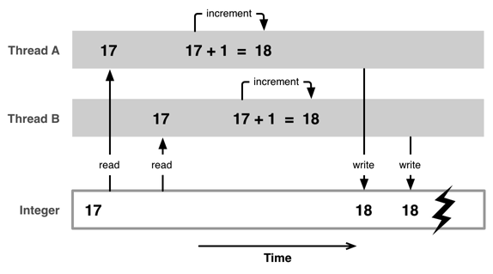
Synchronization
A shared resource may be corrupted if it is accessed simultaneously by multiple threads.

Slide 4
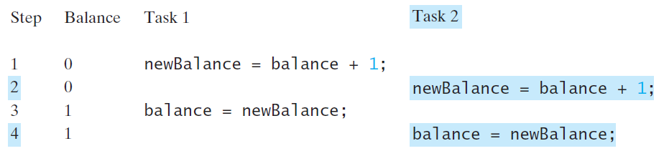
Bank account : The problem

Slide 5
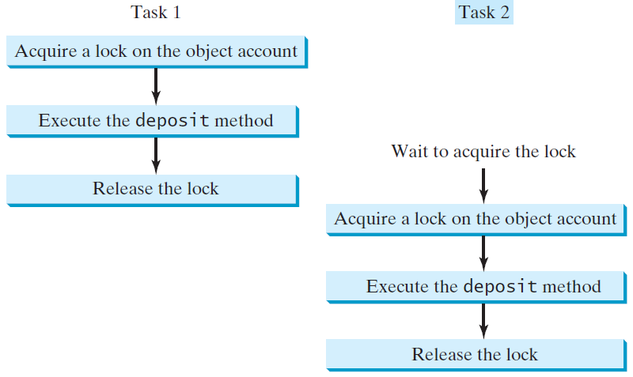
Bank account : A solution

Slide 6
Outline
Synchronization
  Volatile
  Synchronized
  ReentrantLock
DeadLock

Slide 7
Outline
Synchronization
  Volatile
  Synchronized
  ReentrantLock
DeadLock

Slide 8
Volatile – the anti cache
Enforces no shared variable caching
static class Worker extends Thread {
private volatile boolean running = true;
@Override
public void run() {
while (running) {
try {
Thread.sleep(1000);
} catch (InterruptedException e) {
e.printStackTrace();
}
}
}
public void shutdown(){
running = false;
}
}

Slide 9
Volatile
In action
EX01

Slide 10
Outline
Synchronization
  Volatile
  Synchronized
  ReentrantLock
DeadLock

Slide 11
Outline
Synchronization
  Volatile
  Synchronized
  ReentrantLock
DeadLock

Slide 12
Remember this ?

Slide 13
Synchronized : How ?
Acquire lock : prevents any other thread from acquire the same lock (blocks other threads)
Do the job : this is the critical section the requires synchronization
Release the lock .

Slide 14
Synchronized
Methods :
  Instance
  Static
Statements :
  Uses Any instance of the Object.class as the lock

Slide 15
Synchronized
Instance methods
What is the lock ?
It’s the current instance
private synchronized void increment() {
count++;
}

Slide 16
Synchronized
Static methods
What is the lock ?
It’s the static class
private static synchronized void increment() {
count++;
}

Slide 17
Synchronized
Statements
What is the lock ?
It’s the current instance : this
private void increment() {
synchronized (this){
count++;
}
}

Slide 18
Synchronized
Statements – A better way
What is the lock ?
It’s lock
public class Synchronization {
private int count;
Object lock = new Object();
private void increment() {
synchronized (lock){
count++;
}
}
}

Slide 19
Synchronized
Statements
This is why it’s a
better approach 😅
public class Synchronization {
private int count;
Object lock1 = new Object();
Object lock2 = new Object();
private void increment() {
synchronized (lock1){
count++;
}
}
private void decrement() {
synchronized (lock2){
count--;
}
}
}

Slide 20
Synchronized
In action
Ex02

Slide 21
Outline
Synchronization
  Volatile
  Synchronized
  ReentrantLock
DeadLock

Slide 22
Danger
Next section is for advanced Programmers only

Slide 23
ReentrantLock
A ReentrantLock is unstructured, unlike synchronized construct – i.e. you don't need to use a block structure for locking and can even hold a lock across methods.

Slide 24
ReentrantLock – example
public class ReentrantLockTest {
private ReentrantLock lock = new ReentrantLock();
public void foo() {
// ...
lock.lock();
// ...
}
public void bar() {
// ...
lock.unlock();
//...
}
}

Slide 25
ReentrantLock – When to use ?
When synchronized is limited
  It offers features like timed lock waits, interruptible lock waits, non-block-structured locks, multiple condition variables, or lock polling
When high contention does exist
  contention = a thread that never get a chance to run

Slide 26
ReentrantLock – When to use ?
When synchronized is limited
  It offers features like timed lock waits, interruptible lock waits, non-block-structured locks, multiple condition variables, or lock polling
When high contention does exist
  contention = a thread that never get a chance to run

Slide 27
ReentrantLock
In action
Ex03

Slide 28
Outline
Synchronization
  Volatile
  Synchronized
  ReentrantLock
DeadLock

Slide 29
Outline
Synchronization
  Volatile
  Synchronized
  ReentrantLock
DeadLock

Slide 30
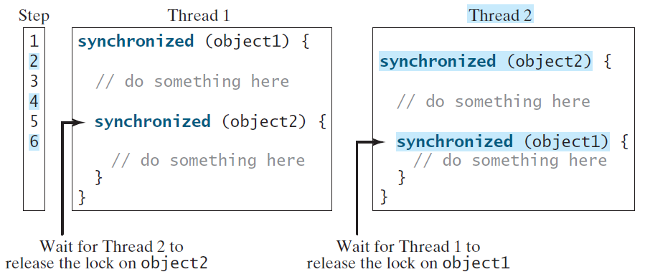
DeadLock

Slide 31
DeadLock – a solution
Resource ordering :
  Inner locks MUST be acquired first.
  In the previous example :
    Thread 2 must obtain Lock on object1 first
    If the lock is not available it blocks (waits)
  Locks are ordered in reverse nested way

Slide 32
DeadLock
In action
Ex04

Slide 33
Outline
Synchronization
  Volatile
  Synchronized
  ReentrantLock
DeadLock

